Slide 1
Predicting Pizza Sales with Machine Learning
Sarath Chandra Balla (ID: 669161466)
Varun Kumar Medi (ID: 652174010)

Slide 2
Presentation Flow
Abstract
Problem Statement
Data Description
Data Preprocessing
Machine Learning Models: SARIMAX, Prophet , XGBoost, LSTM
Evaluation Metrics
Result followed by metric plots, model performance and 30-day prediction using best model
Conclusion

Slide 3
Abstract
Accurate sales forecasting is important in the food and beverage industry, where perishable products need to be stockpiled and variable demand has to be managed. This project forecasts pizza sales on a daily basis by utilizing time series forecasting and machine learning. By discovering a real-world dataset, this project aims to find trends, seasonality, and consumer behavior through data exploration, preprocessing, and model performance. Among various approaches, Long Short-Term Memory (LSTM) networks was the most effective.
The results offer practical benefits to pizza chains, enabling enhanced control over inventory, reduced waste, and targeted marketing. Future research directions also include incorporating external factors, multi-step forecasting, and real-time usage.

Slide 4
Problem Statement
Pizza chains tend to have difficulty making precise day-ahead sales forecasts due to the nature of consumer behavior, the effect of external drivers (e.g., promotions and holidays), and natural seasonality in demand.
The project aims to:
Know Sales Dynamics: Analyze historical sales trends to identify seasonal patterns, trends, and outliers.
Develop Predictive Models: Develop, train, and optimize machine learning models for predicting daily pizza sales.
Evaluate Model Performance: Compare the accuracy, efficiency, and stability of different models.

Slide 5
Data Description
Source: A Kaggle dataset containing detailed information about pizza orders, including specifics about the pizza variants, quantities, pricing, dates, times, and categorization details. https://www.kaggle.com/datasets/nextmillionaire/pizza-sales-dataset
Structure:
Total rows: 48,620
Features: 12 (e.g., `pizza_id`, `order_date`, `quantity`, `pizza_size`)
Duration: Covers a year of data with daily granularity.

Slide 6
Data Preprocessing:
Cleaning:
Checked for no missing values in the dataset.
Dropped redundant columns (`pizza_id`, `order_id`, `pizza_name_id`).
Feature Engineering:
Temporal Features: Extracted `day_of_week` and `is_weekend` features to find time-related patterns.
Categorical Encoding: One-hot encoded `pizza_category` and label encoded `pizza_size`.
Scaling:
Normalized numerical variables for compatibility with LSTM models.
Aggregation:
Aggregated data at the daily level to facilitate easier time series modeling.

Slide 7
Machine Learning Models
Tested multiple models:
SARIMAX: Identifies seasonality but not able to handle multivariate data.
Prophet: Automatically detects trends and seasonality but has limited flexibility.
XGBoost: Employed decision trees blended with gradient boosting for efficient handling of non-linear relationships.
LSTM: Neural network architecture with large ability to handle long-term dependencies in sequential data.

Slide 8
Evaluation Metrics
Evaluation Metrics:
RMSE (Root Mean Squared Error): Computes the mean magnitude of errors.
MAE (Mean Absolute Error): The mean absolute difference from actual.
R² Score: The percentage of variance in the data explained by the model.

Slide 9
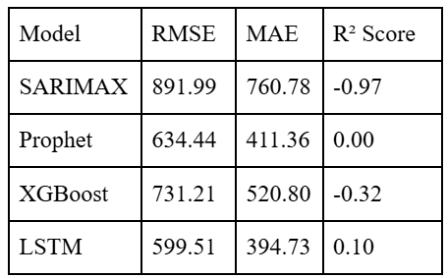
Results
Observations
XGBoost performed best of all the models, having lowest RMSE and highest R².
SARIMAX was a decent baselines but too rigid to handle complicated relationships.
LSTM provided a strong contender with marginally lower accuracy but higher interpretability.

Slide 10
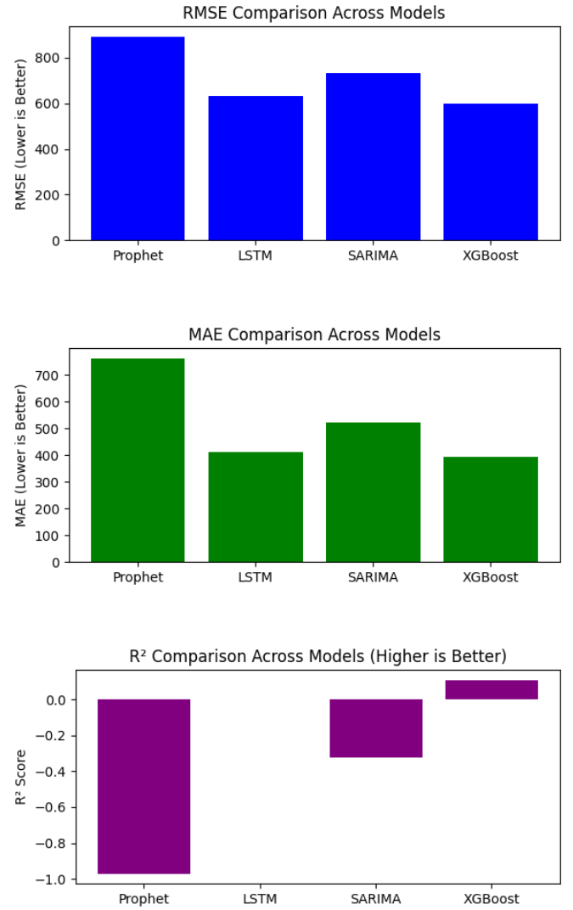
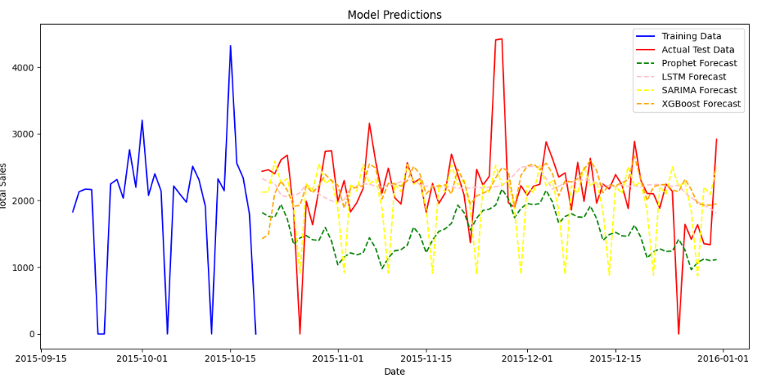

Slide 11
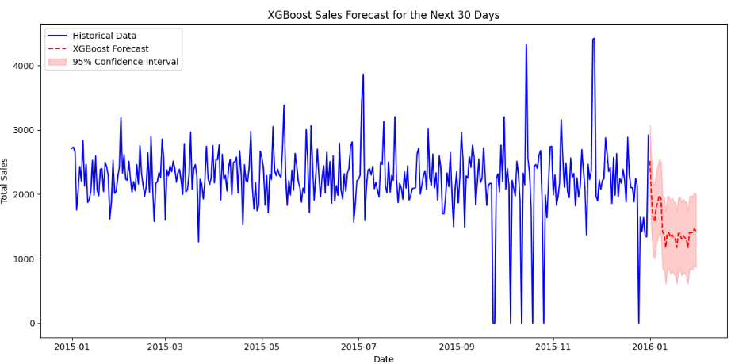
Using the top-performing model (XGBoost) for prediction in the next 30 days.

Slide 12
Conclusion
Advanced models like LSTM and XGBoost evidently outperform traditional methods for pizza sales forecasting.
Feature engineering, especially lag features and temporal aggregation, was crucial to model success.
The project underscores the importance of marrying domain expertise with machine learning techniques.

